Slide 1
Refund & Reconciliation & QB

Slide 4
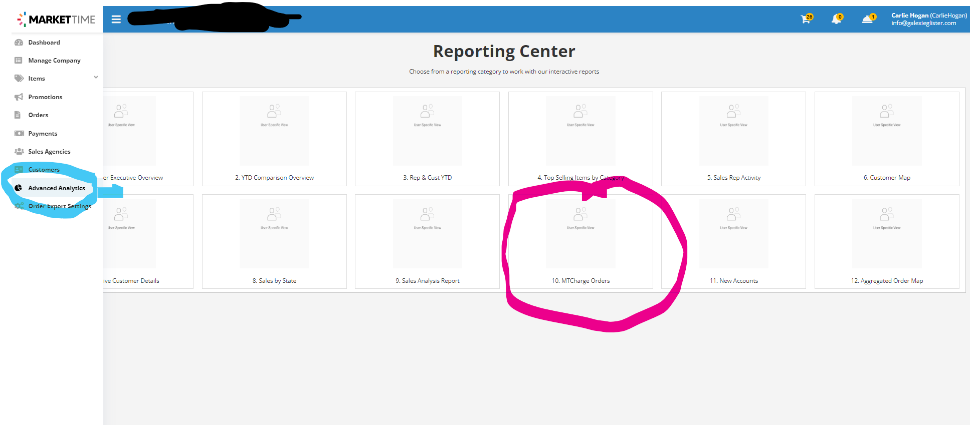

Slide 6
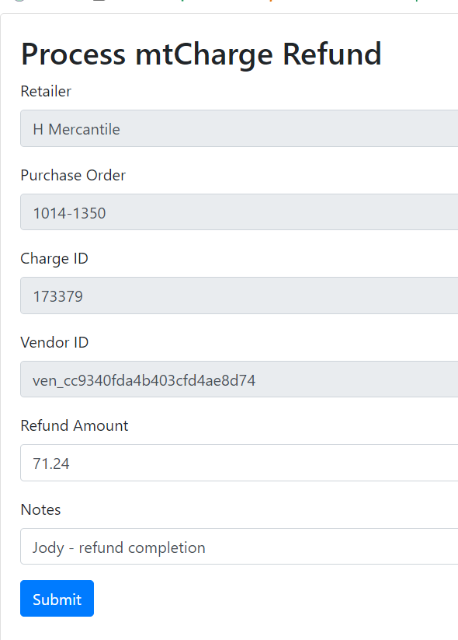
Refunds: Take a screenshot before clicking submit

